Slide 1

Toolkit Doc6 Top Front/Rear Panels
April 28, 2010

Slide 2
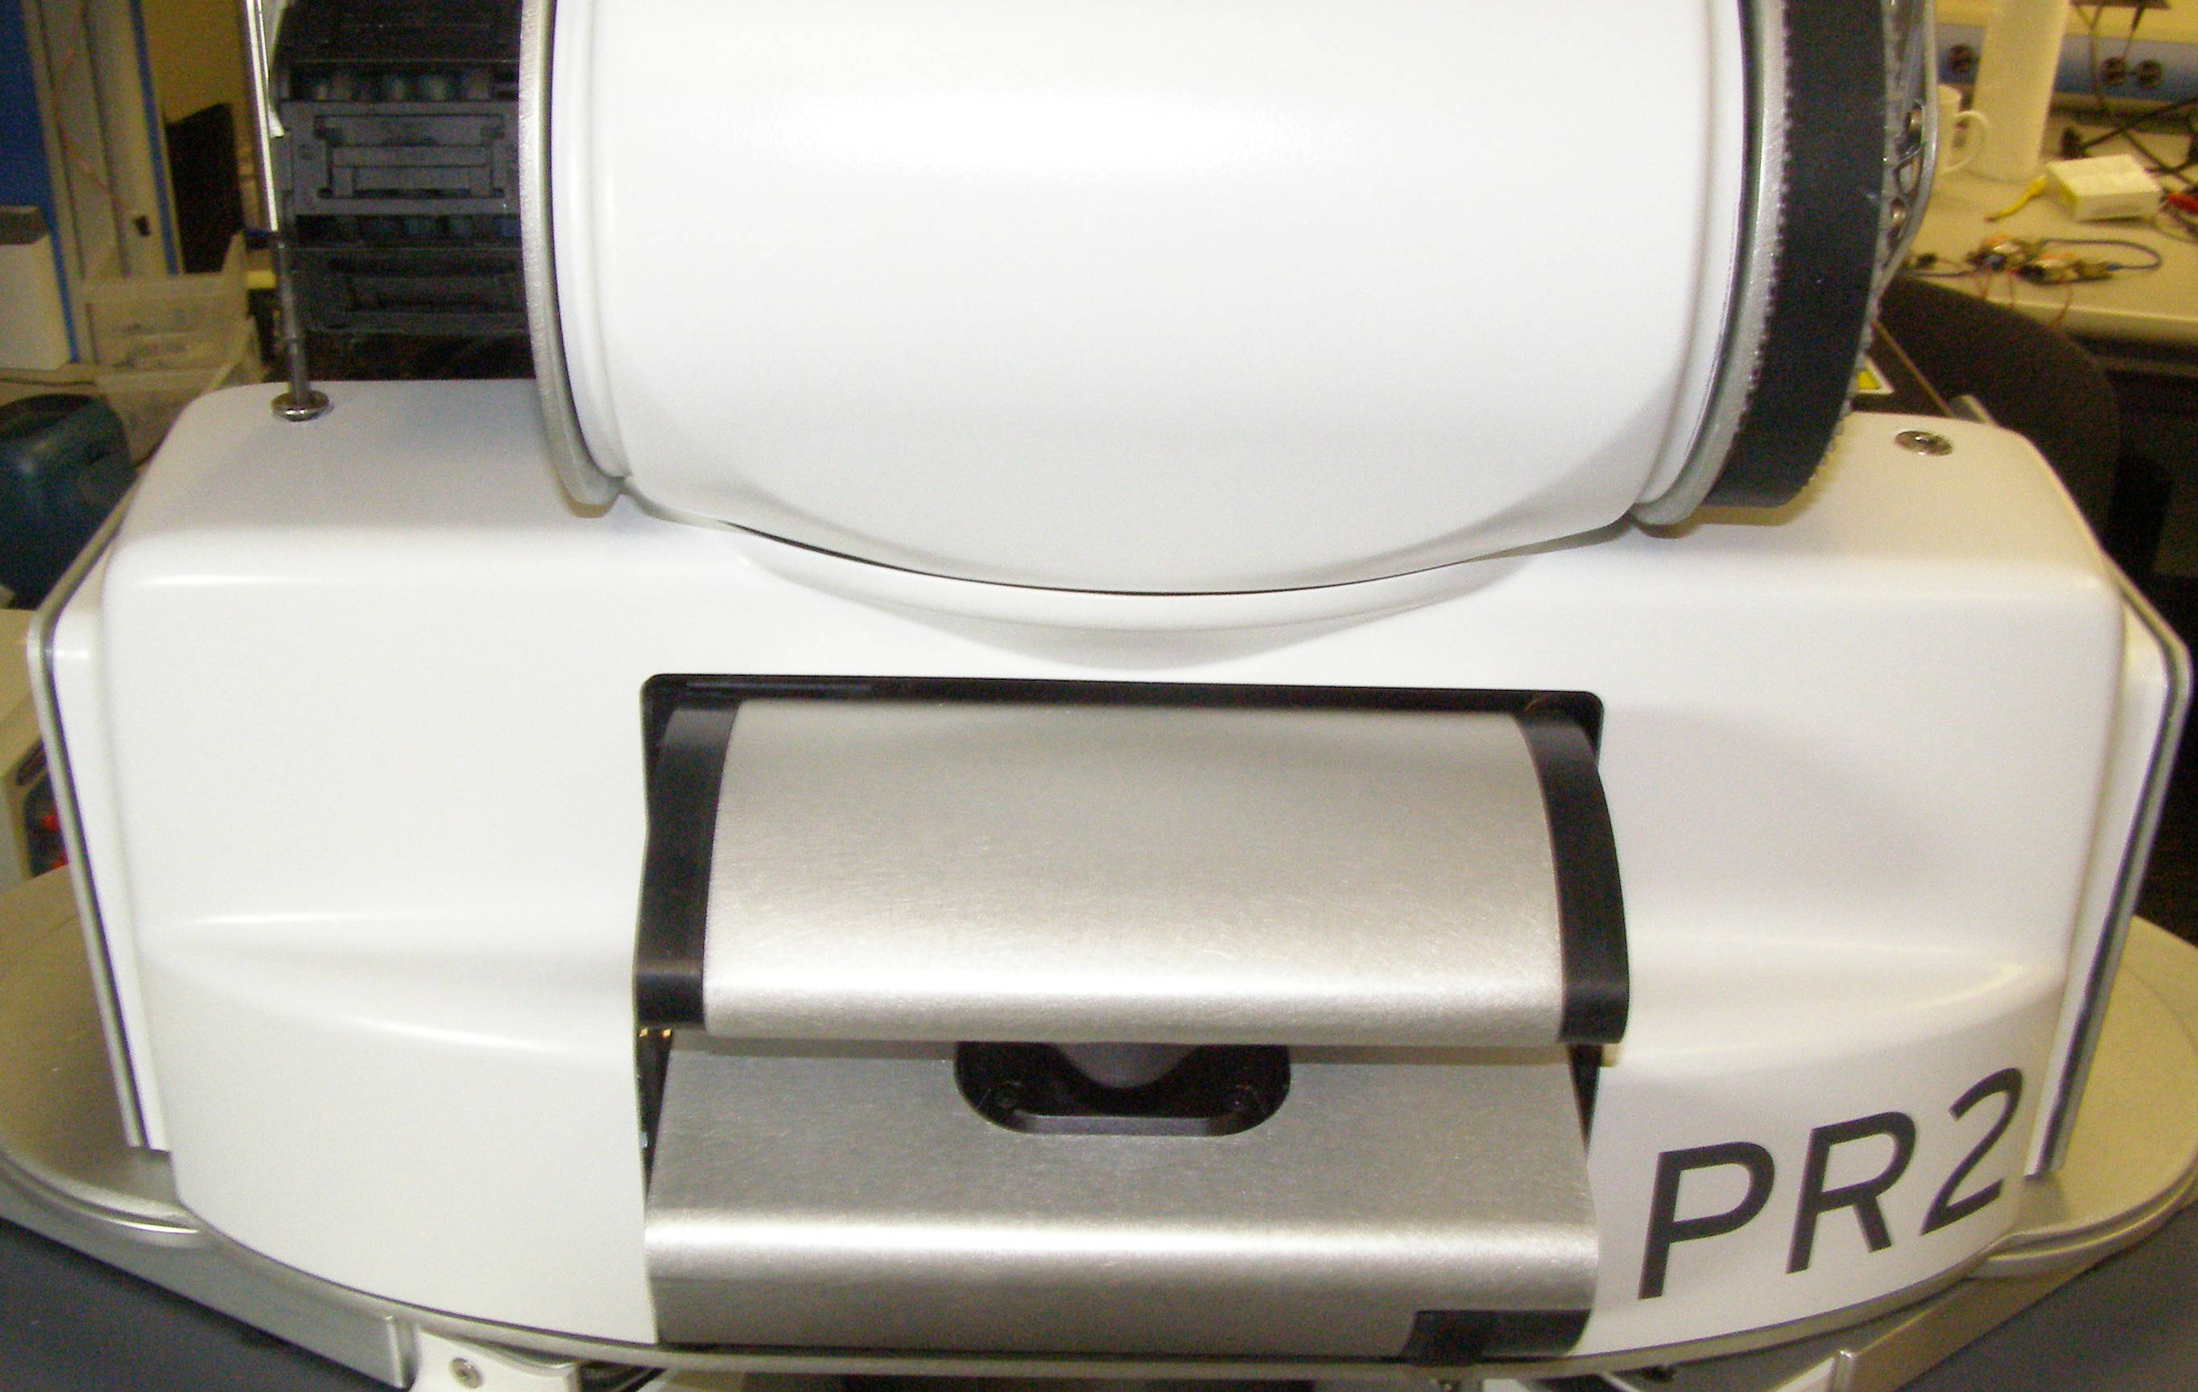
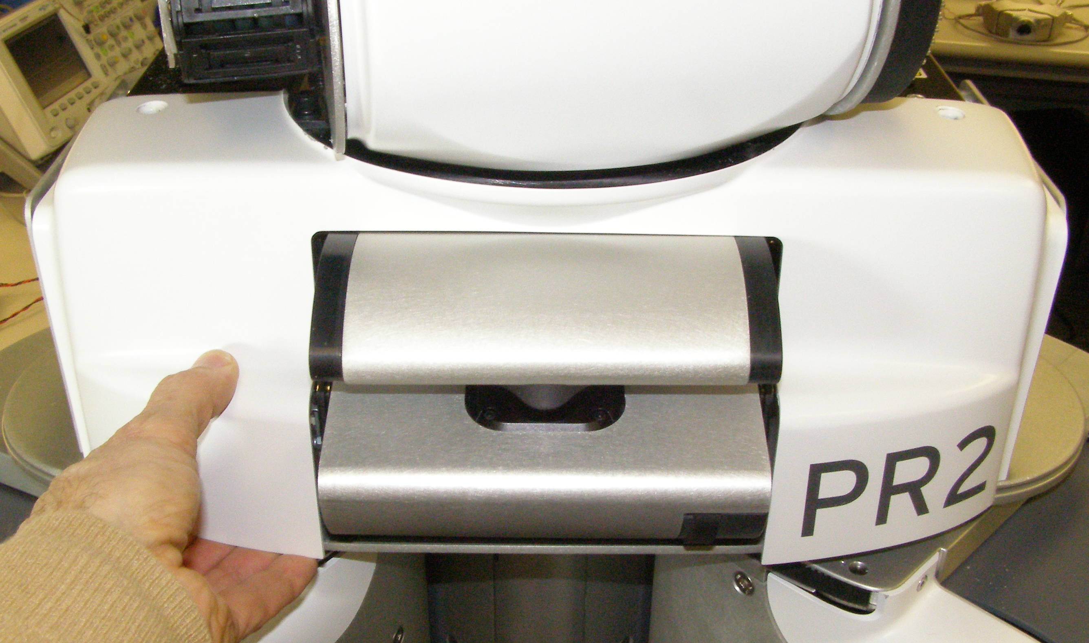
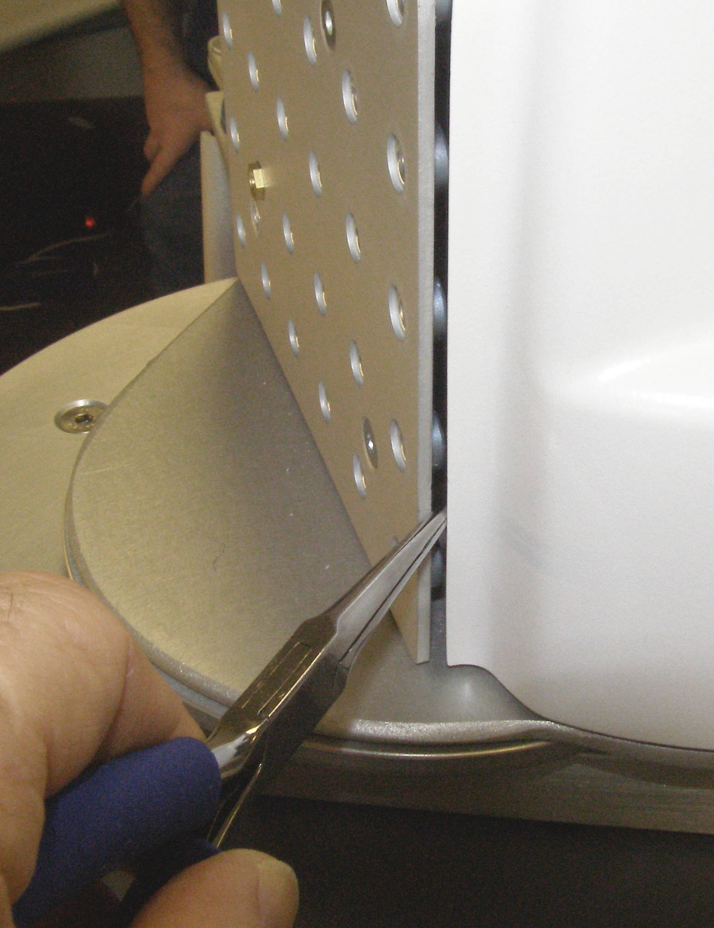
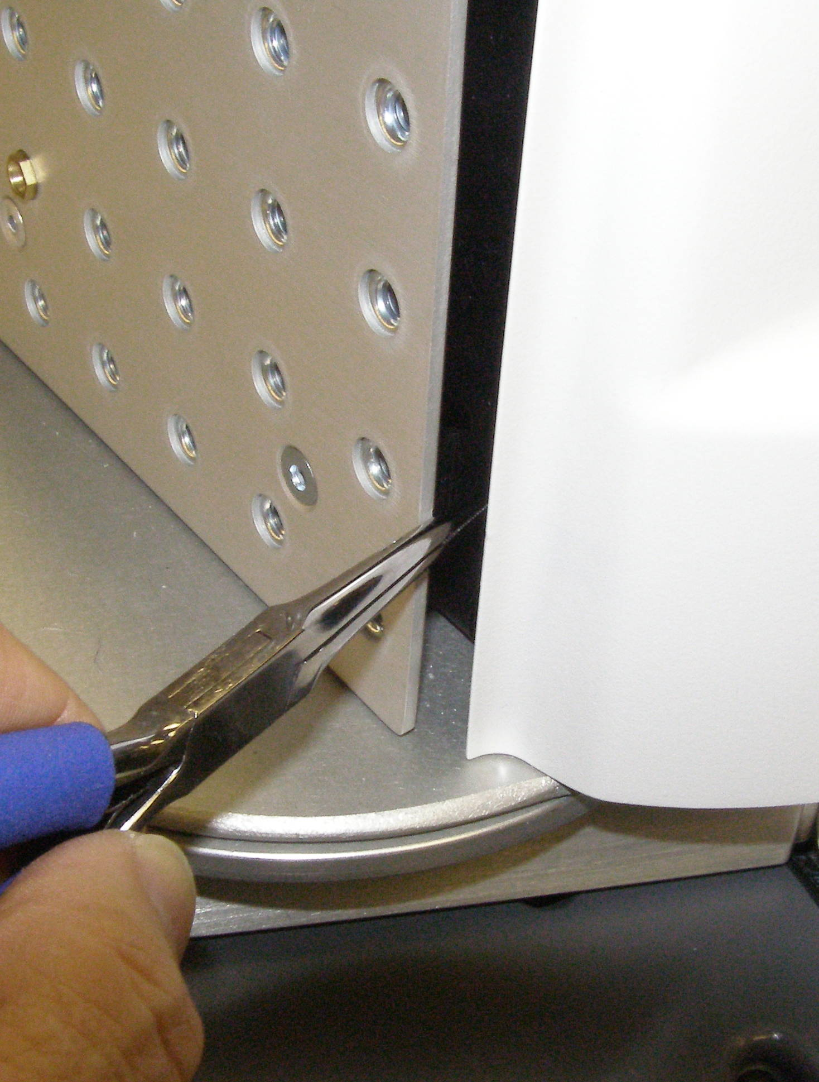
Top Front Panel R/R
Top Front Panel, Removal - 2180
  Using the 4mm bit with the T-handle driver, remove the 2 screws one on each side. 3063-14 (Fig 1)
  Using the Needle Nose pliers or a small Flathead screwdriver, about 4cm from the bottom, gently pry the Collar forward until the snap releases. Do this on both sides. (Fig 2,3)
  Slide the Panel out by pulling straight forward. You may have to lift it slightly to clear a bolt on the right side. (Fig 4)
Top Front Panel, Install
  Reverse the removal procedure.
  Push the bottom of the Panel on both sides until the snaps engage.
  Using Loctite 248, install the 2 Flathead screws and torque to 1.58Nm using the Large torque driver.
Fig 1
Fig 4
Fig 2
Fig 3

Slide 3
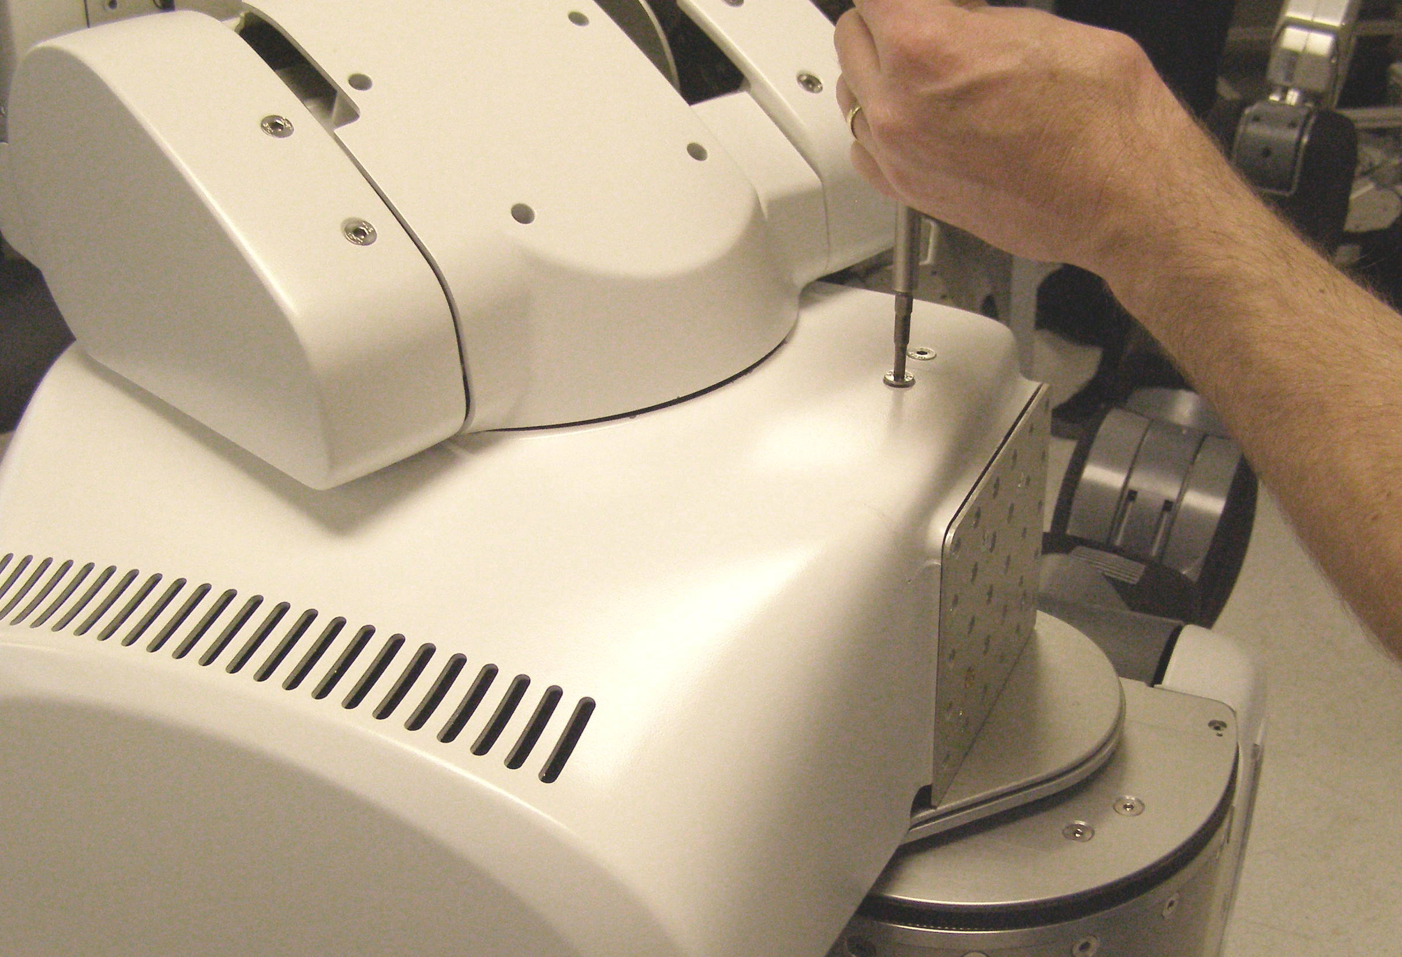
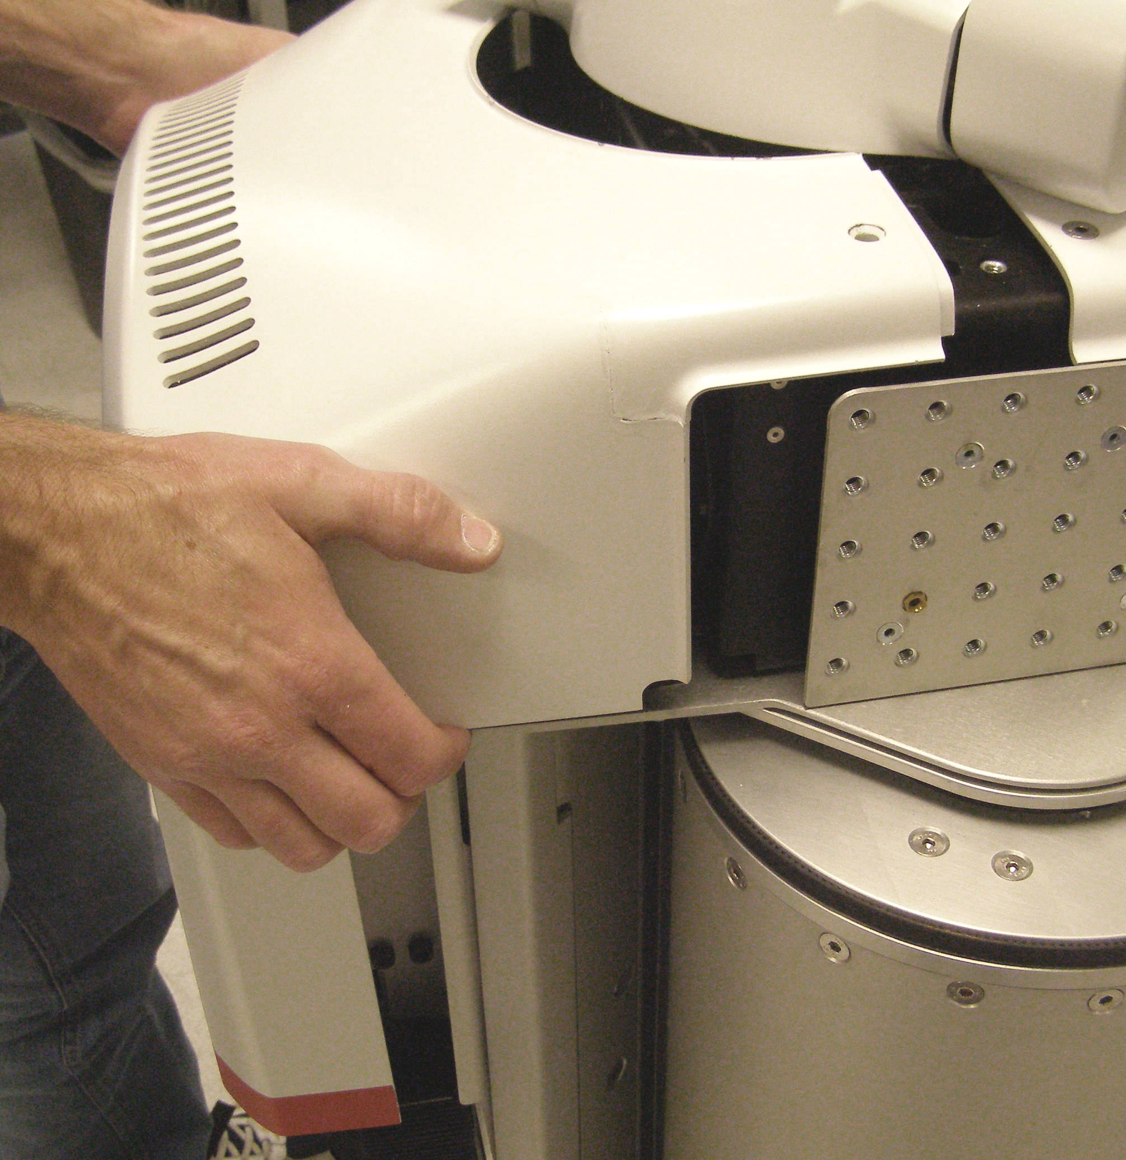
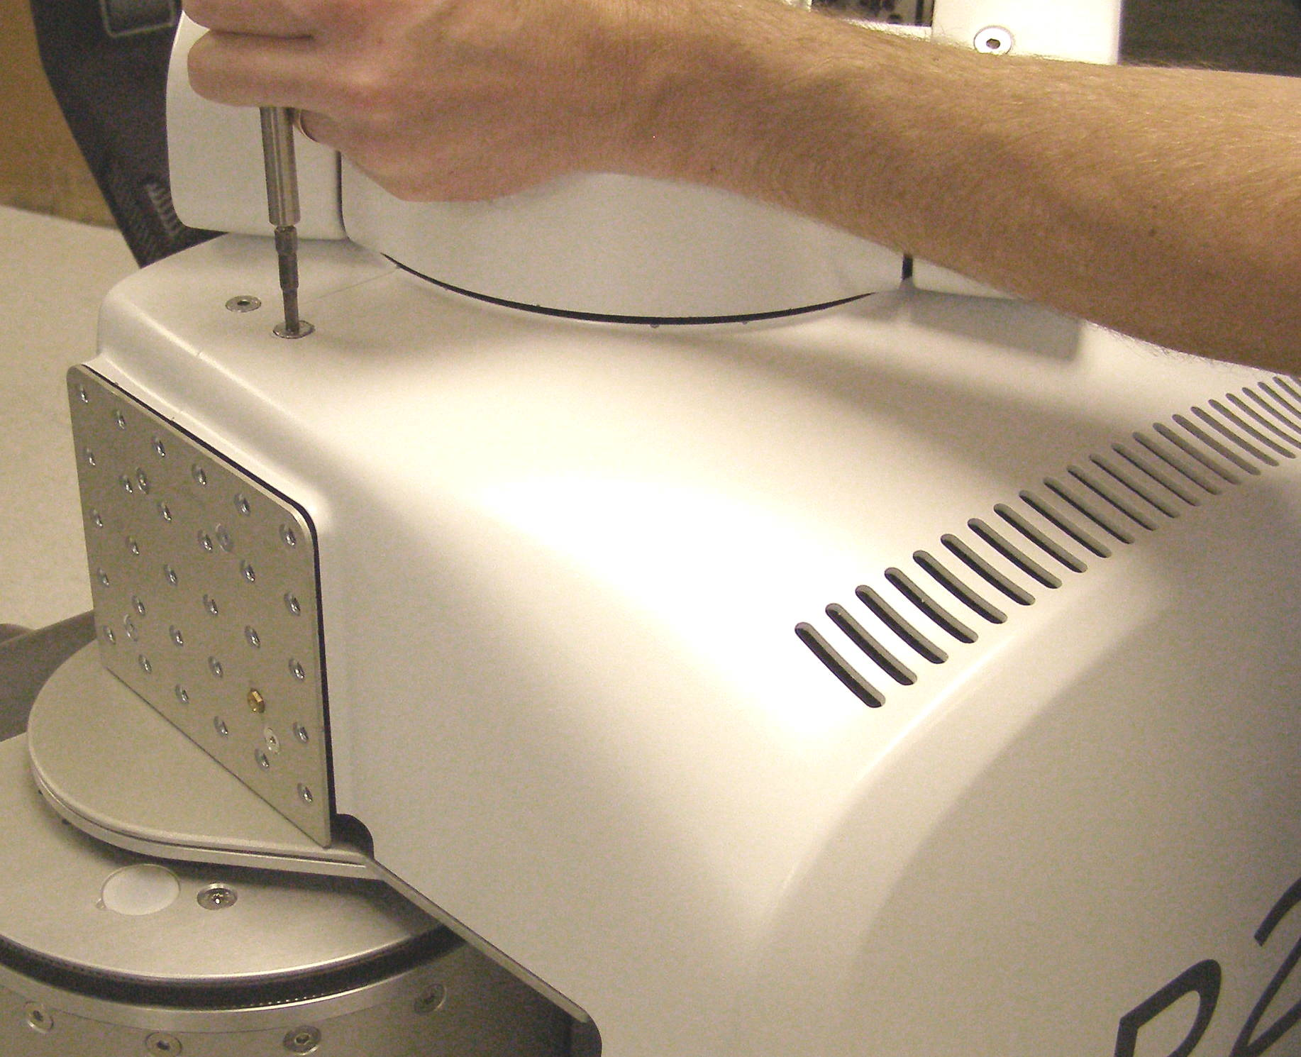
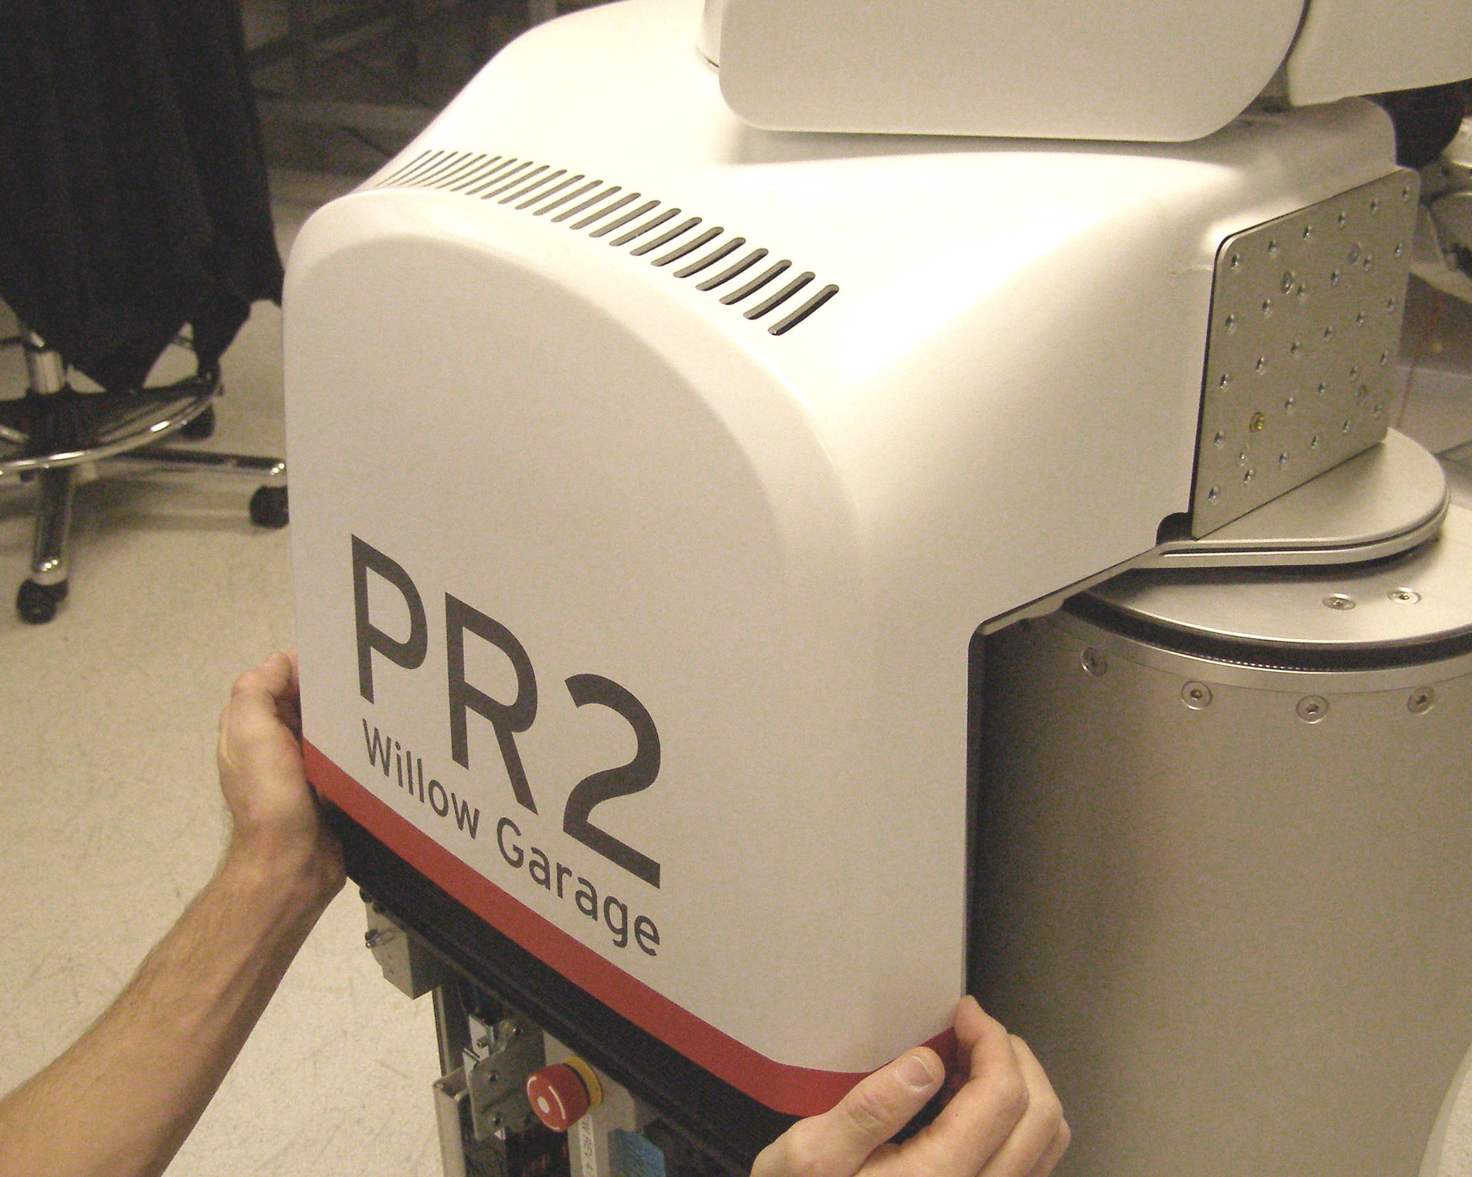
Rear Top Panel R/R
Rear Top Panel, Removal - 2175
  Using the 5mm bit with the T-handle driver, remove the 2 screws one on each side. 3063-14 (Fig 1)
  Pulling firmly on the bottom edge or sides of the Panel, release the 2 snaps. (Fig 3)
  While gently lifting the right side, pull straight back slowly rock the Panel off being aware that it is a tight fit under the Head Pan Rear Panel. (Fig 4)
Rear Top Panel, Install
  Reverse the removal procedure.
  Push the bottom of the Panel on both sides until the snaps engage.
  Using Loctite 248, install the 2 Flathead screws and torque to 1.58Nm using the Large torque driver.
Fig 1
Fig 4
Fig 2
Fig 3

